Slide 1

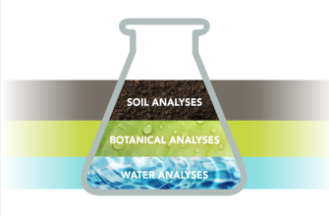
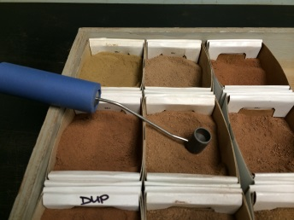
ALP
Proficiency Testing Services
Robert Miller and Chris Czyryca
Celebrating 18 years of Service

Slide 2


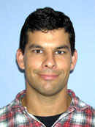
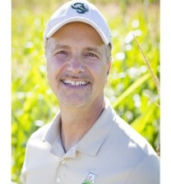

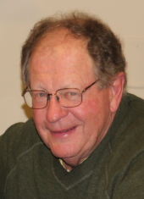


ALP Team
Program Staff
Chris Cyzryca: Program Director, CTS, 18 yrs
Robert Miller, PhD: Technical Director, 18 yrs
Byron Vaughan, PhD: Technical Advisor, 16 yrs
Larry May, PhD: Materials Manager, 9 yrs
Irene Venteicher: Packaging/Shipping Coordinator, 9 yrs
The ALP Program is managed by Collaborative Testing Services, with 48 years professional experience providing lab proficiency testing services.
Accredited: ALP is the only accredited proficiency provider for agricultural proficiency testing in North America, ISO/IEC 17043 by ANAB.
Miller and Czyryca, 2023

Slide 3


ALP by the numbers
The ALP soils program is the most comprehensive lab PT program providing lab proficiency results on both method bias and lab precision.
Proficiency soils are diverse, collected across North America, representing a broad range of soil chemical and physical properties.
Reports are comprehensive listing method performance (bias and precision) each soil.
3,307,500
analyses¹
245 soils
analyzed
144 labs
1 Proficiency Team
- Accredited -
¹ Number of soils x analyses x labs x reps.
Miller and Czyryca, 2023

Slide 4
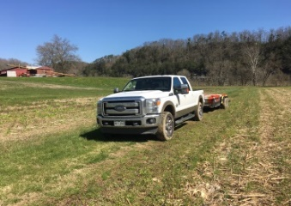
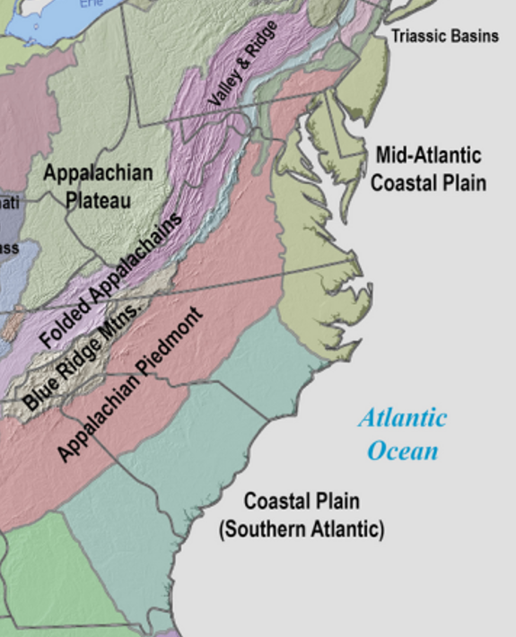
MASTPAWG soil collections
ALP has collected 28 soils across the Mid-Atlantic region since 2006, representing five physiographic units, and provide proficiency testing services to 11 labs across the region.
Proficiency soil preparation
air dried (< 4% moisture)
pulverized, and power sieved
fibrous root material removed
power sieved 2nd time
V shell bulk blended, 60 minutes
homogeneity quality tested
PT soils are homogeneity tested, 8 test parameters, five jars randomly selected, each analyzed in triplicate. Results published.

Slide 5

Proficiency soil consistency
Standard reference soil SRS-1812 was re-submitted after four years as SRS-2206. More than 98% of parameter medians, were within the measurement MAD.
EC, NO₃-N, M3-K, M3-Zn, SOM-LOI and SOC the median values were reproducible to two significant digits.
Results verify ALP standard reference soils proficiency median and MAD statistical results are highly reproducible and remarkedly stable over four years.
Analysis | Unit | SRS-1812 | SRS-2206
 |  | Median | Median
EC (1:1) | dS/m | 0.647 | 0.643
pH (1:1) salt |  | 6.94 | 7.01
NO₃-N | mg kg⁻¹ | 19.2 | 19.0
M3-P ICP | mg kg⁻¹ | 27.2 | 29.2
M3-K | mg kg⁻¹ | 419 | 422
M3-Zn | mg kg⁻¹ | 2.13 | 2.11
SOM-LOI | % | 4.15 | 4.10
SOC | % | 1.963 | 1.984
¹ Laboratory soil median values.
Miller and Czyryca, 2023

Slide 6
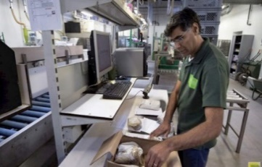

ALP cost, service and support
Cost
  Low cost, basic soil PT program $540/yr, 3 cycles
  Three PT cycles per year, lower lab analysis cost.
Service
  Retest soil sample kits (14 shipped in 2022)
  Standard reference soils, quantities 0.5, 1.0, 20.0 kg
  Double blind PT soil evaluations
Support
  Laboratory technical consultation
    Byron Vaughan, 20 years commercial lab experience
    Mike Lindaman, 26 years experience managing commercial lab
    Steve Meghan, 24 years lab director Univ of Idaho, A2LA assessor
Miller and Czyryca, 2023

Slide 7

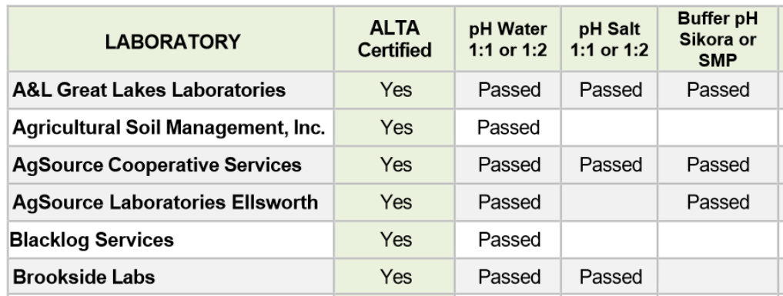
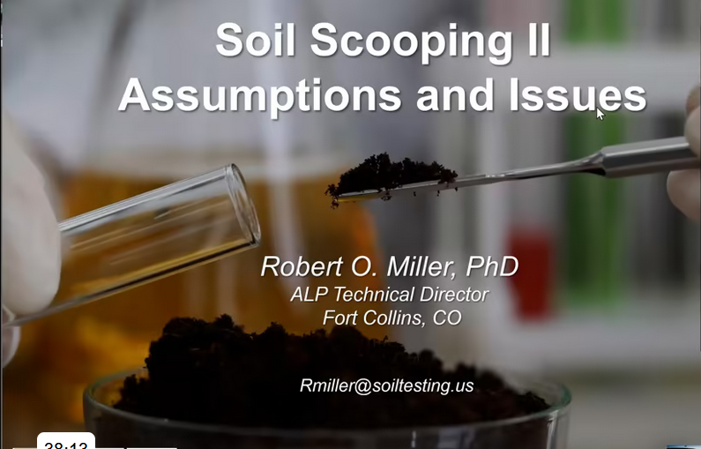
ALP - ALTA collaboration
ALP collaborates with the Agricultural Laboratory Testing Association, for certifying soil analysis laboratories and providing training webinars.
Certification. The ALTA-SAC program evaluates lab soil pH, P, K analysis each ALP cycle based on 80% passing score each parameter.
Lab Webinars: ALP has assisted in the development of seven ALTA training webinars.
Laboratory quality management
The laboratory SOP
Basics of lab quality control
Determining the method detection limit
Soil scooping – part I and part II
Lab PT failure analysis part I
Miller and Czyryca, 2023

Slide 8


ALTA March webinar
ICP Analysis & Calibration, Jason Lessl, University of Georgia
March 7, 2023, 11:00 AM EST
Join Zoom Meeting
https://us02web.zoom.us/j/85448975779?pwd=VjF2MCsvekk2WVBGR3ZoS3ZOVXA1Zz09
Meeting ID: 854 4897 5779
Passcode: 834508
ALTA.ag
Contact Gary Fisher, ALTA Secretary: info@alta.ag
Scan for web site
Miller and Czyryca, 2023

Slide 9
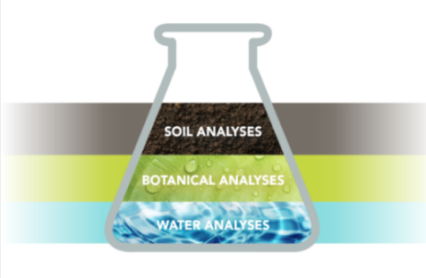
2023 ALP update
Sponsorship of the 17th International Symposium on Soil and Plant Analysis in Conception Chile, March 21-24, 2023.
Addition of soil extractable metals (As, Cd, Cr, Cu, Hg, Ni, Pb, Se Zn) to standard soil proficiency tests, no additional charge.
Adoption of AgGateway Modus v2 soil library method codes for the proficiency testing program.
To enroll: Chris: christopher.czyryca@cts-interlab.com
Miller and Czyryca, 2023

Slide 10


Modus library
Standardizing agricultural lab test data is an important enabler of principled decision-making in agriculture and its estimated ~70% of soil tests results are electronically-exchanged in the US.
AgGateway is a global, non-profit organization that helps agri-businesses expand their ability to exchange and use data and has been working on laboratory data information standard for farm management information systems (FMIS).
The laboratory methods library (Modus) was initially developed in 2013 focusing on Ag analyses using a controlled xml vocabulary across multiple Ag matrices. 2018 schema expanded: soil, plant, water, manure, nematodes.

Slide 11
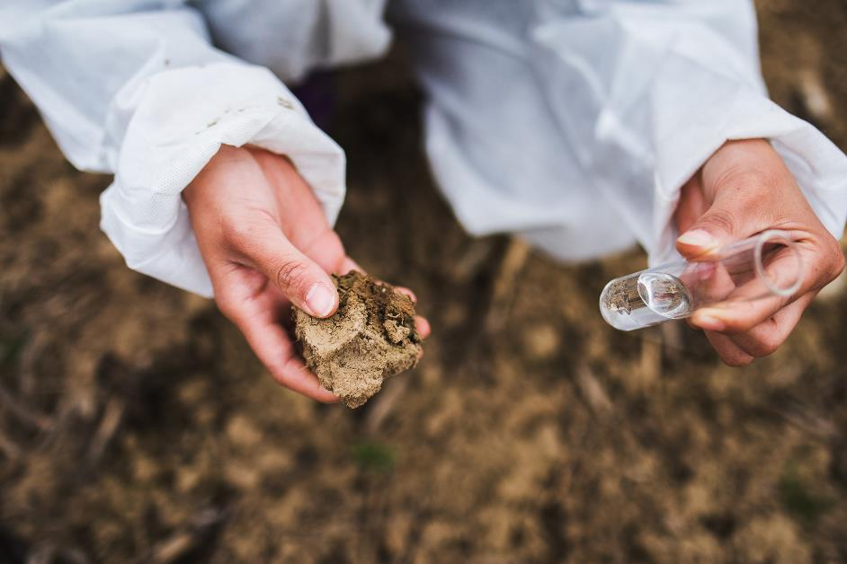
Modus soil library structure
Example
Matrix
Phosphorus
Additional identifiers:
Alternate reporting unit
Method: measured or calculated
Acceptance criteria: official, provisional, experimental, proprietary
Regional work group approval
Former Modus v 1.0 code ID
Reference citation
Mehlich 3
Soil
Formulation
Analyte
Extraction basis
Extraction ratio
Method
Extraction time
Instrument ICP
806 Soil methods
Reporting unit

Slide 12
Modus v2 soil P example
Matrix | Analyte | Extraction Name | Extraction reagent | Extraction Ratio | Extraction Basis | Extraction Time | Analyte Measurement | Aggregation Method | Reporting Unit | Alt Reporting Unit | Accept. | Status | Organization
SOIL | P | Mehlich 1 | (0.05 M HCl + 0.0125 M H2SO4) | 1:5 | m/v | 5 min | ICP-OES | Measured | mg/kg | ppm | Official | ACTIVE | SERA-6
SOIL | P | Mehlich 1 | (0.05 M HCl + 0.0125 M H2SO4) | 1:5 | m/v | 5 min | Spec | Measured | mg/kg | ppm | Official | ACTIVE | SERA-6
SOIL | P | Mehlich 2 | (0.2N CH3COOH + 0.015N NH4F + 0.2N NH4Cl + 0.012N HCl) | 1:10 | m/v | 5 min | ICP-OES | Measured | mg/kg | ppm | Official | ACTIVE | NCSU
SOIL | P | Mehlich 2 | (0.2N CH3COOH + 0.015N NH4F + 0.2N NH4Cl + 0.012N HCl) | 1:10 | m/v | 5 min | Spec | Measured | mg/kg | ppm | Official | ACTIVE | NCSU
SOIL | P | Mehlich 3 | (0.2N CH3COOH + 0.25N NH4NO3 + 0.013N HNO3 + 0.015N NH4F + 0.001M EDTA) | 1:10 | v/v | 5 min | ICP-OES | Measured | mg/dm3 | mg/kg | Official | ACTIVE | SERA-6
SOIL | P | Mehlich 3 | (0.2N CH3COOH + 0.25N NH4NO3 + 0.013N HNO3 + 0.015N NH4F + 0.001M EDTA) | 1:10 | v/v | 5 min | Spec | Measured | mg/dm3 | mg/kg | Official | ACTIVE | SERA-6
SOIL | P | Mehlich 3 | (0.2N CH3COOH + 0.25N NH4NO3 + 0.013N HNO3 + 0.015N NH4F + 0.001M EDTA) | 1:10 | m/v | 5 min | ICP-OES | Measured | mg/kg | ppm | Official | ACTIVE | SERA-6, NCERA-13, NEC-1812
SOIL | P | Mehlich 3 | (0.2N CH3COOH + 0.25N NH4NO3 + 0.013N HNO3 + 0.015N NH4F + 0.001M EDTA) | 1:10 | m/v | 5 min | Spec | Measured | mg/kg | ppm | Official | ACTIVE | SERA-6, NCERA-13, NEC-1812
52 soil P extraction methods, additional 12 calculated P methods.

Slide 13
What’s New in Modus v2.0?
  More precise in describing test methods, some v1.0 methods could be ambiguous and in some cases map to more than one v2.0 method.
  Includes more information about each test method broke out so categorizing or searching/filtering methods is easier and more accurate.
  Includes a reference to the citation for a test method where possible, so it is very clear on the method being described.
  Applies the ISO19156 principles for observing and measuring and reporting the results unambiguously, meaning the data is organized in a more structured way with better semantic and syntactic descriptions.
  V2.0 is a dynamic, living standard. Clear process and support to handle addition of new methods via AgGateway standard processes providing ongoing stewardship for Modus.

Slide 14
AgGateway
WG04 Ag Lab Data Standardization Committee
  Ben Cracker, AgGateway
  Andres Ferreyra, Syngenta Digital
  Randall Warden, A&L Great Lakes
  Robert Miller, ALP Program
  Jodi Jaynes, Sure-Tech
  Jason Ellsworth, Wilbur Ellis
  Brad Joern, Precision Planting
  Corey Lacey, United Soils
ModusStandard.org
https://www.aggateway.org/Portals/1010/2020-04-07%20Soils%20Flyer-SR.pdf?ver=2020-04-07-114007-097

Slide 16
Modus Agronomic
Testing Lab Standard
State in 2018:
  Most adopted format within the lab industry
  Strong for its Controlled Vocabulary
  XML format
  Existing Schema: Soil, Plant, Water, Manure, Nematodes
Needed to:
  Become a true “Open Source” product with a clear license
  (“rules of engagement”)
  Set up a process for future maintenance and progress
  Evolve to other serialization formats like JSON
  Clean up the vocabularies, create version 2, engage the certification organizations
Moved to
AgGateway

Slide 17










ALP a network that drives lab quality
International PT providers
Regional soil
workgroups
SERA-IEG-6
NECC-1312
Lab industry
associations
NCERA-13
Miller and Czyryca, 2023

Slide 18

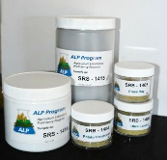
MASTPAWG soil collections
ALP has collected 28 soils across the Mid-Atlantic region since 2006, representing four physiographic units, and provide proficiency testing services to 11 labs across the region.
Mid Atlantic soil collection 2018

Slide 19
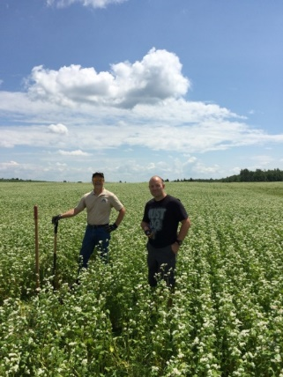
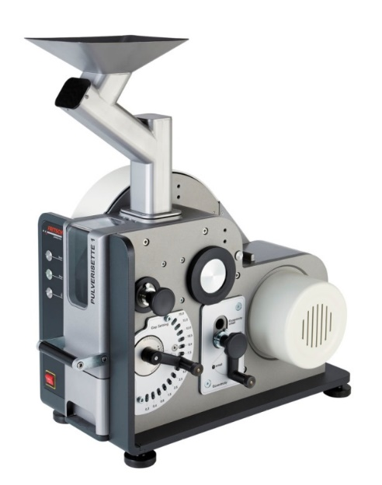
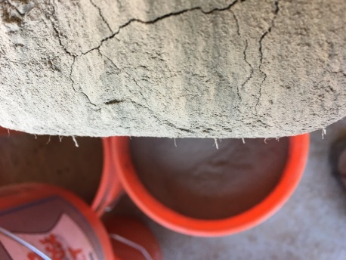
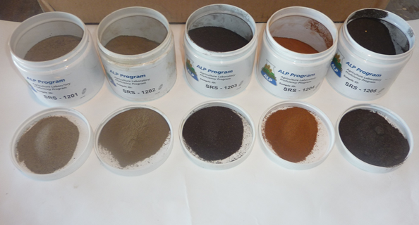
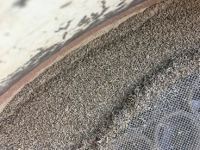

PT soil preparation
Proficiency soil preparation
PT soils are homogeneity tested, 8 test parameters (pH, EC, Buf pH, NO₃-N, P, K, SOM, Zn), five jars randomly selected, each analyzed in triplicate. Results published.
air dried (< 4% moisture)
pulverized, and power sieved
fibrous root material removed
power sieved 2nd time
V shell bulk blended, 60 minutes
homogeneity quality tested
Miller and Czyryca, 2023

Slide 20

Service and support
Service
  Retest soil sample kits (14 shipped in 2022)
  Standard reference soils, quantities 0.5, 1.0, 20.0 kg
  Double blind PT soil evaluations
Support
  Technical support method/instrumentation
  Laboratory consultation
    Byron Vaughan, 20 years commercial lab experience
    Mike Lindaman, 26 years managing commercial lab
    Steve Meghan, 24 years lab director U of Idaho, A2LA assessor
Miller and Czyryca, 2023

